Slide 1
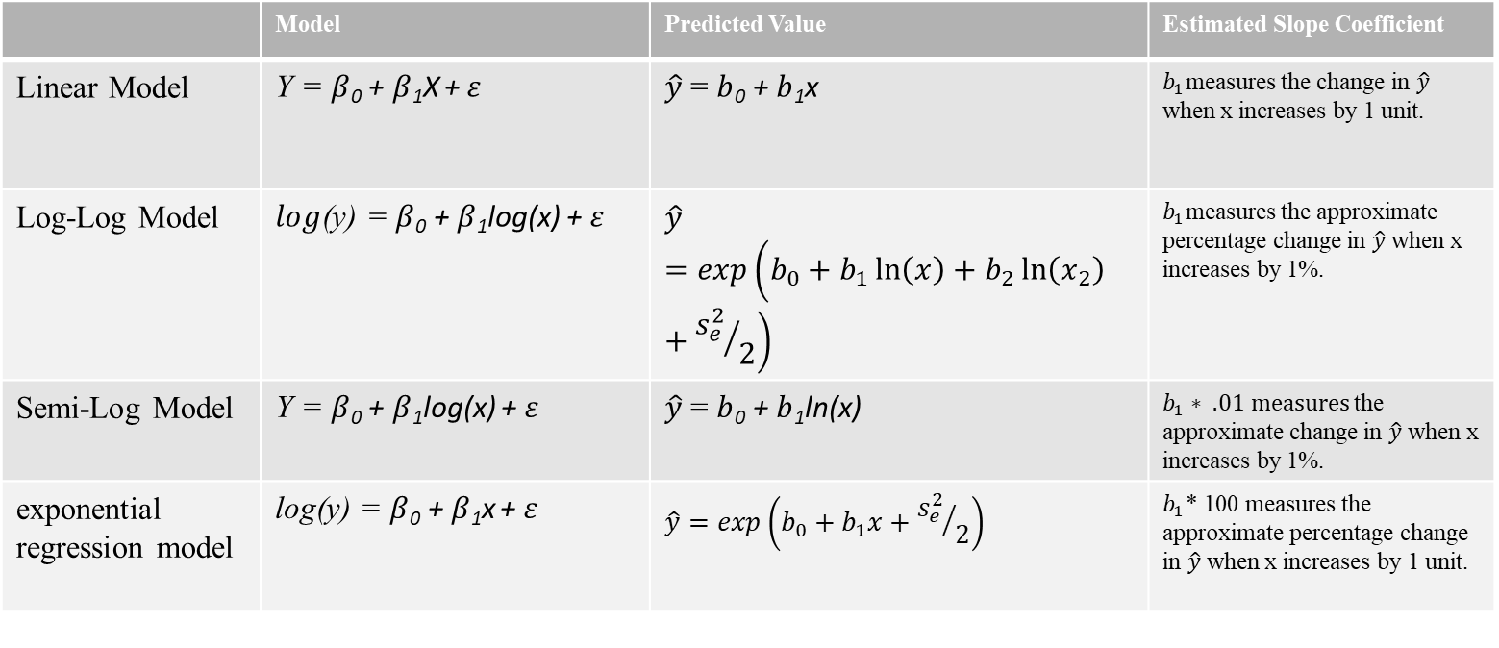
Looking at the Prediction Equations with Variable Transformations
 | Model | Predicted Value | Estimated Slope Coefficient
Linear Model | Y = $β$₀ + $β$₁X $\text{+} ε$ | $\hat{y}$ = $b$₀ + $b$₁x | $b_{1}$measures the change in $\hat{y}$ when x increases by 1 unit.
Log-Log Model | $log$(y) = $β$₀ + $β$₁log(x) $\text{+} ε$ | $$\hat{y}=exp\left(b_{0}+b_{1}\ln\left(x\right)+b_{2}\ln\left(x_{2}\right)+{s_{e}^{2}}/2\right)$$ | $b_{1}$measures the approximate percentage change in $\hat{y}$ when x increases by 1%.
Semi-Log Model | Y = $β$₀ + $β$₁log(x) $\text{+} ε$ | $\hat{y}$ = $b$₀ + $b$₁ln(x) | $b_{1}∗ .01 measures$the approximate change in $\hat{y}$ when x increases by 1%.
exponential regression model | log(y) = $β$₀ + $β$₁x $\text{+} ε$ | $$\hat{y}=exp\left(b_{0}+b_{1}x+{s_{e}^{2}}/2\right)$$ | $b_{1}$* 100 measures the approximate percentage change in $\hat{y}$ when x increases by 1 unit.

Slide 2
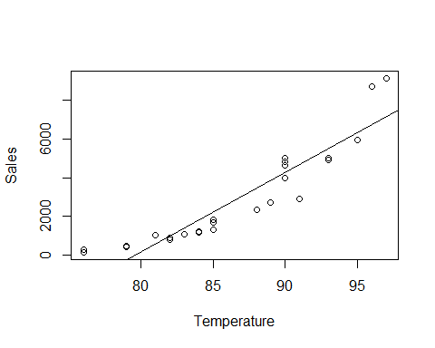
Log Transformations - With No Transformation
lmBev<-lm(Sales~Temperature, data=beverages) summary(lmBev)
## ## Call: ## lm(formula = Sales ~ Temperature, data = beverages) ## ## Residuals: ## Min 1Q Median 3Q Max ## -1773.6 -603.2 -299.1 651.8 1995.8 ## ## Coefficients: ## Estimate Std. Error t value Pr(>|t|) ## (Intercept) -32670.82 2344.98 -13.93 <2e-16 *** ## Temperature 410.44 27.01 15.20 <2e-16 *** ## --- ## Signif. codes: 0 '***' 0.001 '**' 0.01 '*' 0.05 '.' 0.1 ' ' 1 ## ## Residual standard error: 1013 on 40 degrees of freedom ## Multiple R-squared: 0.8523, Adjusted R-squared: 0.8486 ## F-statistic: 230.9 on 1 and 40 DF, p-value: < 2.2e-16
cor(lmBev$fitted.values, Sales)^2
## [1] 0.8523335
plot(Sales~Temperature, data=beverages) abline(lmBev)

Slide 3
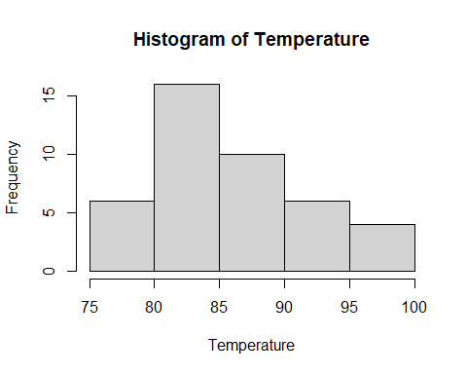
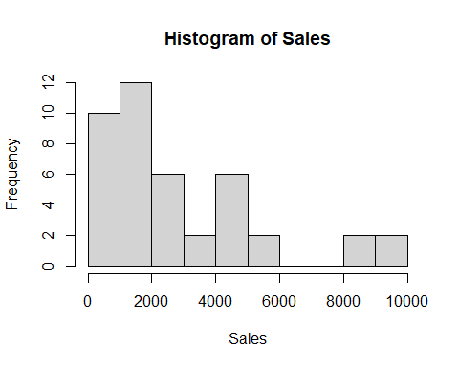
hist(Temperature)
hist(Sales)

Slide 4
Log-Log - Transformation both an X and Y variable
lmBevLogLog<-lm(log(Sales)~log(Temperature), data=beverages) summary(lmBevLogLog)
## ## Call: ## lm(formula = log(Sales) ~ log(Temperature), data = beverages) ## ## Residuals: ## Min 1Q Median 3Q Max ## -0.65901 -0.09604 -0.02699 0.07140 0.39400 ## ## Coefficients: ## Estimate Std. Error t value Pr(>|t|) ## (Intercept) -59.0117 2.1712 -27.18 <2e-16 *** ## log(Temperature) 14.9195 0.4868 30.65 <2e-16 *** ## --- ## Signif. codes: 0 '***' 0.001 '**' 0.01 '*' 0.05 '.' 0.1 ' ' 1 ## ## Residual standard error: 0.2107 on 40 degrees of freedom ## Multiple R-squared: 0.9591, Adjusted R-squared: 0.9581 ## F-statistic: 939.2 on 1 and 40 DF, p-value: < 2.2e-16
Sig <- sigma(lmBevLogLog); Sig ##rse
## [1] 0.2107096
b0 <- lmBevLogLog$coefficients[1]; b0
## (Intercept) ## -59.0117
b1 <- lmBevLogLog$coefficients[2]; b1
## log(Temperature) ## 14.9195
yhat <- exp(b0 + b1*log(Temperature) + Sig^2/2) loglogcor <- cor(yhat, Sales)^2; loglogcor
## [1] 0.9435362

Slide 5
Semi Log - Transforming an X variable
lmBevSemiLog<-lm(Sales~log(Temperature), data=beverages) summary(lmBevSemiLog)
## ## Call: ## lm(formula = Sales ~ log(Temperature), data = beverages) ## ## Residuals: ## Min 1Q Median 3Q Max ## -1787.3 -677.8 -259.4 651.2 2201.3 ## ## Coefficients: ## Estimate Std. Error t value Pr(>|t|) ## (Intercept) -153792 11126 -13.82 <2e-16 *** ## log(Temperature) 35134 2495 14.08 <2e-16 *** ## --- ## Signif. codes: 0 '***' 0.001 '**' 0.01 '*' 0.05 '.' 0.1 ' ' 1 ## ## Residual standard error: 1080 on 40 degrees of freedom ## Multiple R-squared: 0.8322, Adjusted R-squared: 0.828 ## F-statistic: 198.3 on 1 and 40 DF, p-value: < 2.2e-16
b0 <- lmBevSemiLog$coefficients[1]; b0
## (Intercept) ## -153792.3
b1 <- lmBevSemiLog$coefficients[2]; b1
## log(Temperature) ## 35134.23
yhat <- (b0 + b1*log(Temperature)) logXcor <- cor(yhat, Sales)^2; logXcor
## [1] 0.8321751
Same number because Y is still Y

Slide 6
ExpLog Log - Transforming a Y variable
lmBevExpLog<-lm(log(Sales)~Temperature, data=beverages) summary(lmBevExpLog)
## ## Call: ## lm(formula = log(Sales) ~ Temperature, data = beverages) ## ## Residuals: ## Min 1Q Median 3Q Max ## -0.75513 -0.10680 -0.02097 0.08882 0.41848 ## ## Coefficients: ## Estimate Std. Error t value Pr(>|t|) ## (Intercept) -7.342357 0.529312 -13.87 <2e-16 *** ## Temperature 0.171567 0.006097 28.14 <2e-16 *** ## --- ## Signif. codes: 0 '***' 0.001 '**' 0.01 '*' 0.05 '.' 0.1 ' ' 1 ## ## Residual standard error: 0.2286 on 40 degrees of freedom ## Multiple R-squared: 0.9519, Adjusted R-squared: 0.9507 ## F-statistic: 791.8 on 1 and 40 DF, p-value: < 2.2e-16
cor(lmBevExpLog$fitted.values, Sales)^2
## [1] 0.8523335
Sig <- sigma(lmBevLogLog); Sig ##rse
## [1] 0.2107096
b0 <- lmBevExpLog$coefficients[1]; b0
## (Intercept) ## -7.342357
b1 <- lmBevExpLog$coefficients[2]; b1
## Temperature ## 0.1715675
yhat <- exp(b0 + b1*Temperature + Sig^2/2) logycor <- cor(yhat, Sales)^2; logycor
## [1] 0.9373075

Slide 7
Categorical Data
Using factors in R to handle variables that have levels.
Including qualitative data, or data that is non-numerical in nature.

Slide 8
Categorical
Information that is sorted into categories
Ordinal - Clear ordering to the categories.
Age when categories are listed like : <18, between 18 and 25, Between 25 and 35, and Greater than 35.
Survey Items like Agreement Scales – Strongly Disagree, Disagree, Neither Disagree or Agree, Agree, or Strongly Agree
Nominal – No intrinsic ordering to the categories.
Education – No College, Some College, Associates Degree, BBA, BS, BA, MBA, MSBA, PHD
Dichotomous or Binary
A nominal variable with 2 categories
Locality – Rural or Urban
Gender – Male or Female
Smoker – Yes or No

Slide 9
Regression With Categorical Variables
Regression analysis requires numerical data.
Ordinal variables can be represented by a number in one column when there is even distance between the categories.
From strongly disagree to disagree to N/A to agree to strongly agree. Each 1 unit change considers the same distance between points.
A weighted scale would go from strongly disagree to neither to agree to strongly agree to agree all the time.
Need to manually code these and coerce into a number.
Some ordinal variables need to use dummy coding (i.e., Seasonality). Need to always check rationale before blindly recoding to numbers, or using numbers that were provided.
Nominal categorical data can be included as independent variables, but must be coded numeric using dummy variables.
R will turn create the dummy variables automatically in a regression.
For variables with 2 categories, code as 0 and 1.

Slide 10
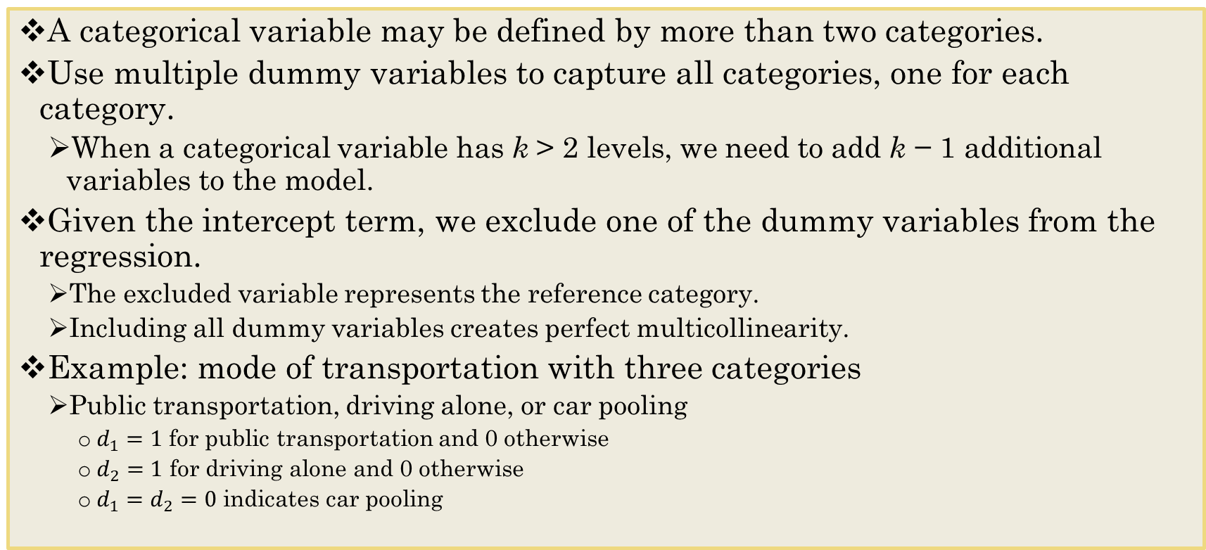
Dummy Variables with More than 2 Categories
A categorical variable may be defined by more than two categories.
Use multiple dummy variables to capture all categories, one for each category.
When a categorical variable has k > 2 levels, we need to add k − 1 additional variables to the model.
Given the intercept term, we exclude one of the dummy variables from the regression.
The excluded variable represents the reference category.
Including all dummy variables creates perfect multicollinearity.
Example: mode of transportation with three categories
Public transportation, driving alone, or car pooling
$d_{1}=1$ for public transportation and 0 otherwise
$d_{2}=1$ for driving alone and 0 otherwise
$d_{1}=d_{2}=0$ indicates car pooling

Slide 11
Example Of Recoding in R
Take a vector representing gender
gender <- c("MALE","FEMALE","FEMALE","UNKNOWN","MALE")
One way is to convert the data into numerical in the column using ifelse statements.
ifelse(gender == "MALE", 1, ifelse(gender == "FEMALE", 2, 99))
## [1] 1 2 2 99 1
Slope estimates of categorical data cannot be evaluated the same way. In the example above, since Gender is nominal, and because we are using regression, we should use dummy variables to process this factor in the regression instead of the method above. We can use this technique for ordinal variables to recode them into numeric.

Slide 12
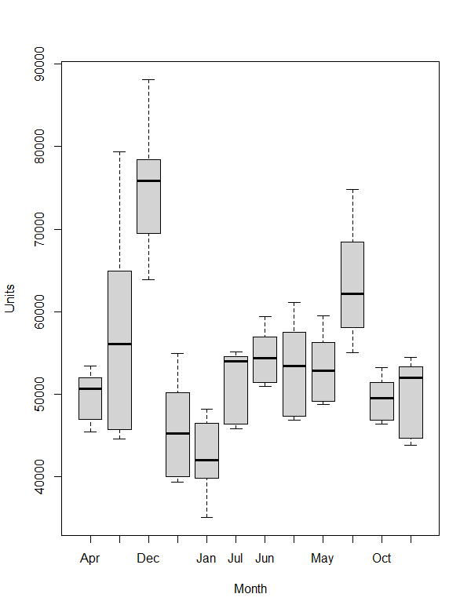
Seasonal Dummy Variables
Suppose that we are forecasting and we want to account for the month as a predictor.
Then the following dummy variables can be created
sales <- read.csv("months.csv", stringsAsFactors = TRUE)
str(sales)
'data.frame': 132 obs. of 3 variables:
$ Month: Factor w/ 12 levels "Apr","Aug","Dec",..: 1 2 3 4 5 6 7 8 9 10 ...
$ Year : int 2010 2010 2010 2010 2010 2010 2010 2010 2010 2010 ...
$ Units: int 45420 44558 63844 39338 35000 45747 50923 46786 48696 55000 ...

Slide 13
Seasonal Dummy Variables
lmSales<-lm(Units~Month, data=sales)
summary(lmSales)
Call:
lm(formula = Units ~ Month, data = sales)
Residuals:
Min 1Q Median 3Q Max
-12724.5 -4056.6 -36.3 3620.9 22066.5
Coefficients:
Estimate Std. Error t value Pr(>|t|)
(Intercept) 49580.8 1749.6 28.339 < 2e-16 ***
MonthAug 7701.6 2474.2 3.113 0.00232 **
MonthDec 25245.7 2474.2 10.203 < 2e-16 ***
MonthFeb -3744.7 2474.2 -1.513 0.13279
MonthJan -6939.5 2474.2 -2.805 0.00588 **
MonthJul 1809.8 2474.2 0.731 0.46592
MonthJun 4971.5 2474.2 2.009 0.04675 *
MonthMar 3671.9 2474.2 1.484 0.14042
MonthMay 3652.1 2474.2 1.476 0.14255
MonthNov 14205.6 2474.2 5.741 7.21e-08 ***
MonthOct -125.4 2474.2 -0.051 0.95967
MonthSep 261.8 2474.2 0.106 0.91590
---
Signif. codes: 0 ‘***’ 0.001 ‘**’ 0.01 ‘*’ 0.05 ‘.’ 0.1 ‘ ’ 1
Residual standard error: 5803 on 120 degrees of freedom
Multiple R-squared: 0.6857, Adjusted R-squared: 0.6569
F-statistic: 23.8 on 11 and 120 DF, p-value: < 2.2e-16
The interpretation of each of the coefficients associated with the dummy variables is that it is a measure of the effect of that category relative to the omitted category.
In the example to the left, the intercept coefficient is associated with April, so MonthAug measures the effect of August on the forecast variable (Units) compared to the effect of April.

Slide 14
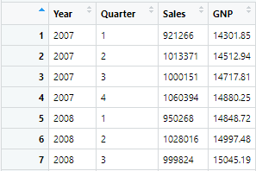
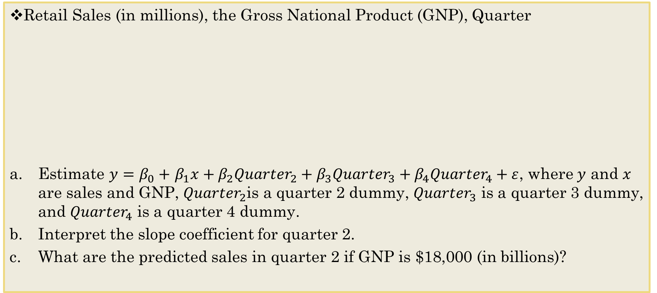
Example: GNP predicting Sales
Retail Sales (in millions), the Gross National Product (GNP), Quarter
Estimate $y=β_{0}+$ $β_{1}x+β_{2}{Quarter}_{2}+β_{3}{Quarter}_{3}+β_{4}{Quarter}_{4}+ε$, where $y$ and $x$ are sales and GNP, ${Quarter}_{2}$is a quarter 2 dummy, ${Quarter}_{3}$ is a quarter 3 dummy, and ${Quarter}_{4}$ is a quarter 4 dummy.
Interpret the slope coefficient for quarter 2.
What are the predicted sales in quarter 2 if GNP is $18,000 (in billions)?
Variable Category | Quarter 2 Dummy | Quarter 3 Dummy | Quarter 4 Dummy
Quarter 1 | 0 | 0 | 0
Quarter 2 | 1 | 0 | 0
Quarter 3 | 0 | 1 | 0
Quarter 4 | 0 | 0 | 1
Note - Quarter 1 is the reference category.

Slide 15
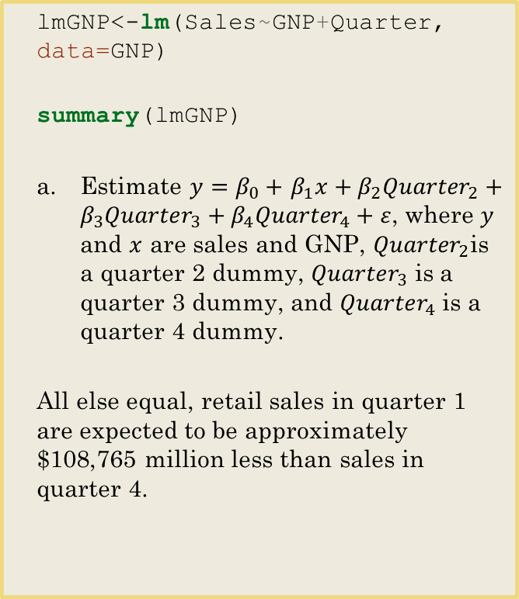
Creating the Regression Object
lmGNP<-lm(Sales~GNP+Quarter, data=GNP)
summary(lmGNP)
Estimate $y=β_{0}+$ $β_{1}x+β_{2}{Quarter}_{2}+β_{3}{Quarter}_{3}+β_{4}{Quarter}_{4}+ε$, where $y$ and $x$ are sales and GNP, ${Quarter}_{2}$is a quarter 2 dummy, ${Quarter}_{3}$ is a quarter 3 dummy, and ${Quarter}_{4}$ is a quarter 4 dummy.
All else equal, retail sales in quarter 1 are expected to be approximately $108,765 million less than sales in quarter 4.
## Call: ## lm(formula = Sales ~ GNP + Quarter, data = GNP) ## ## Residuals: ## Min 1Q Median 3Q Max ## -53748 -20083 -700 16341 52626 ## ## Coefficients: ## Estimate Std. Error t value Pr(>|t|) ## (Intercept) -61669.572 52583.805 -1.173 0.249 ## GNP 65.055 3.215 20.234 < 2e-16 *** ## Quarter2 78278.963 13576.443 5.766 1.57e-06 *** ## Quarter3 59960.212 13607.096 4.407 9.49e-05 *** ## Quarter4 108765.258 13638.197 7.975 2.21e-09 *** ## --- ## Signif. codes: 0 '***' 0.001 '**' 0.01 '*' 0.05 '.' 0.1 ' ' 1 ## ## Residual standard error: 30330 on 35 degrees of freedom ## Multiple R-squared: 0.9364, Adjusted R-squared: 0.9291 ## F-statistic: 128.7 on 4 and 35 DF, p-value: < 2.2e-16

Slide 16
Predicting Y
b. Interpret the slope coefficient for quarter 2.
c. What are the predicted sales in quarter 2 if GNP is $18,000 (in billions)?
Intercept + estimate_for_GNP *Quart2Value + Estimate_for_Quarter2
Quarter2GNP<-18000 coef(lmGNP)
## (Intercept) GNP Quarter2 Quarter3 Quarter4 ## -61669.57208 65.05476 78278.96330 59960.21187 108765.25801
-61669.57208 + 65.05476 * Quarter2GNP + 78278.963 + Quarter3 *0 + Quarter4 *0
## [1] 1187595

Slide 17
Data Wrangling: Collapsing Categories
It is important to keep the integrity of the data in tack.
You can often combine columns/rows to increase the expected counts that are too low.
May make it more difficult to interpret.
May make it easier to interpret.
Must avoid simply trying to combine cells to produce a significant result.
Need solid rationale and theory for making the combination.
How much do you like learning about Regression?
1) Extreme dislike
2) Dislike a lot
3) Dislike a little
4) Don’t have an opinion
5) Like a little
6) Like a lot
7) Extreme like
Could we combine 1 and 2 and 6 and 7?
Not recommended here because those selections refer to different things.

Slide 18
Example: Examining Ethnicity as a Predictor of Salary
What about ethnic categories?
What all ways can people collect ethic information?
How many categories are there?
American Indian or Alaska Native. A person having origins in any of the original peoples of North and South America (including Central America), and who maintains tribal affiliation or community attachment.
Asian. A person having origins in any of the original peoples of the Far East, Southeast Asia, or the Indian subcontinent including, for example, Cambodia, China, India, Japan, Korea, Malaysia, Pakistan, the Philippine Islands, Thailand, and Vietnam.
Black or African American. A person having origins in any of the black racial groups of Africa. Terms such as "Haitian" or "Negro" can be used in addition to "Black or African American."
Hispanic or Latino. A person of Cuban, Mexican, Puerto Rican, South or Central American, or other Spanish culture or origin, regardless of race. The term, "Spanish origin," can be used in addition to "Hispanic or Latino."
Native Hawaiian or Other Pacific Islander. A person having origins in any of the original peoples of Hawaii, Guam, Samoa, or other Pacific Islands.
White. A person having origins in any of the original peoples of Europe, the Middle East, or North Africa.
What if a check all that apply was added? How many categories then?
What if you could not test what you needed to because some categories were mostly empty? Is it appropriate to combine categories then?
Notes:
https://grants.nih.gov/grants/guide/notice-files/not-od-15-089.html

Slide 19
To Do
Work Through Categorical Swirl
Case 3 Group Project has Launched
Asynchronous Class on Friday. You may watch video at any point during the weekend before our next class next Tuesday.

